Slide 1
Decision Trees

Slide 2
Decision Tree Concept
Decision tree: A flowchart for classification and regression (Hence: Classification And Regression Tree – CART)
Type of supervised machine learning
Account = savings?
Yes
No
Balance > 5000?
Transaction = deposit?
Yes
No
Yes
No
Fraud = No
Fraud = Yes
Fraud = No
Fraud = Yes

Slide 3
Exercise
You are a loan officer and decide whether to approve/reject a loan application based on two attributes
Income level (Categorical): High/Medium/Low
Credit history (Categorical): Good/Bad
Target variable
Loan approval (Approve/Reject)
Sample data
Calculate entropy
Initial
After split on income level
After split on credit history
Income level | Credit history | Loan approval
High | Good | Approve
Medium | Good | Approve
Low | Good | Approve
High | Bad | Approve
Medium | Bad | Reject
Low | Bad | Reject

Slide 4
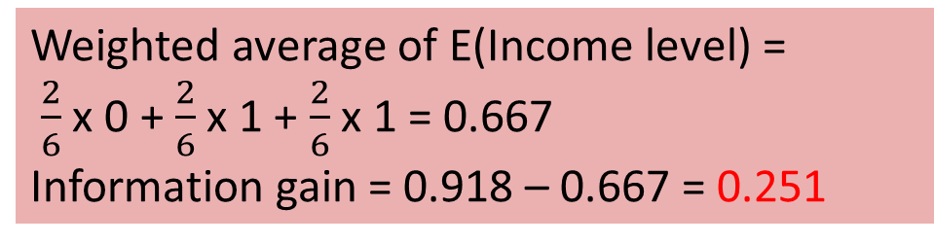

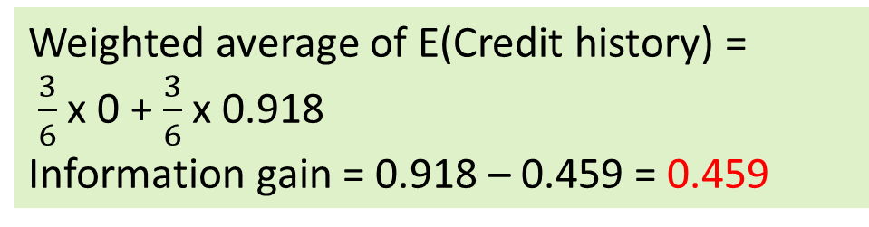
Solution
Income level | Credit history | Loan approval
High | Good | Approve
Medium | Good | Approve
Low | Good | Approve
High | Bad | Approve
Medium | Bad | Reject
Low | Bad | Reject
Overall entropy
E(Original) = $\frac{4}{6}$ log₂ $\frac{4}{6}$ + $\frac{2}{6}$ log₂ $\frac{2}{6}$
E(Original) = 0.918
Splitting on Income level
E(High) = $\frac{2}{2}$ log₂ $\frac{2}{2}$ + $\frac{0}{2}$ log₂ $\frac{0}{2}$ = 0
E(Medium) = $\frac{1}{2}$ log₂ $\frac{1}{2}$ + $\frac{1}{2}$ log₂ $\frac{0}{2}$ = 1
E(Low) = $\frac{1}{2}$ log₂ $\frac{1}{2}$ + $\frac{1}{2}$ log₂ $\frac{0}{2}$ = 1
Splitting on Credit history
E(Good) = $\frac{3}{3}$ log₂ $\frac{3}{3}$ + $\frac{0}{3}$ log₂ $\frac{0}{3}$ = 0
E(Bad) = $\frac{1}{3}$ log₂ $\frac{1}{3}$ + $\frac{2}{3}$ log₂ $\frac{2}{3}$ = 0.918
Weighted average of E(Income level) =
$\frac{2}{6}$ x 0 + $\frac{2}{6}$ x 1 + $\frac{2}{6}$ x 1 = 0.667
Information gain = 0.918 – 0.667 = 0.251
Weighted average of E(Credit history) =
$\frac{3}{6}$ x 0 + $\frac{3}{6}$ x 0.918
Information gain = 0.918 – 0.459 = 0.459
Decision: Split on Credit history first

Slide 5
Next Step
After splitting on Credit history
For Good: All outcomes are Approve, so entropy = 0
For Bad: Calculate entropy and information gain by splitting on Income level
Income level = High: Approve = 1, Reject = 0, so entropy = 0
Income level = Medium: Approve = 0, Reject = 1, so entropy = 0
Income level = Low: Approve = 0, Reject = 1, so entropy = 0
Since all the subsets have 0 entropy, no further splitting is necessary
Credit history
Good
Bad
Approve
Income level
High
Medium
High
Approve
Reject
Reject

Slide 6
Deciding the Split
Entropy: Evenness between classes
High entropy: Not good for prediction (e.g. split on Gender)
Low entropy: Good for prediction (e.g. split on Last login)
Information Gain = Entropy before the split - Entropy after the split

Slide 7




Entropy
Entropy: Tells us how homogeneous a dataset is
High entropy: Less homogeneous = High variability
Low entropy: More homogeneous = Low variability

Slide 8
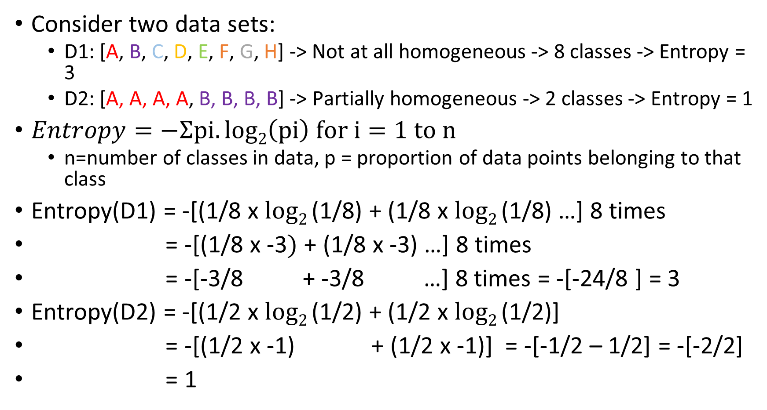
Entropy
Consider two data sets:
D1: [A, B, C, D, E, F, G, H] -> Not at all homogeneous -> 8 classes -> Entropy = 3
D2: [A, A, A, A, B, B, B, B] -> Partially homogeneous -> 2 classes -> Entropy = 1
$Entropy=−Ʃpi.log2\left(pi\right) for i=1 to n$
n=number of classes in data, p = proportion of data points belonging to that class
Entropy(D1) = -[(1/8 x $log2$(1/8) + (1/8 x $log2$(1/8) …] 8 times
= -[(1/8 x -3$)$ + (1/8 x -3) …] 8 times
= -[-3/8 + -3/8 …] 8 times = -[-24/8 ] = 3
Entropy(D2) = -[(1/2 x $log2$(1/2) + (1/2 x $log2$(1/2)]
= -[(1/2 x -1) + (1/2 x -1)] = -[-1/2 – 1/2] = -[-2/2]
= 1

Slide 9
Exercise
We have data about some students. Decide the branching/split by calculating entropy and information gain.
Theory Study | Lab Study | Pass Exam
High | High | Yes
High | Medium | Yes
High | Medium | Yes
High | Low | Yes
Medium | High | Yes
Medium | Medium | No
Medium | Medium | Yes
Medium | Low | No
Low | Low | No

Slide 10
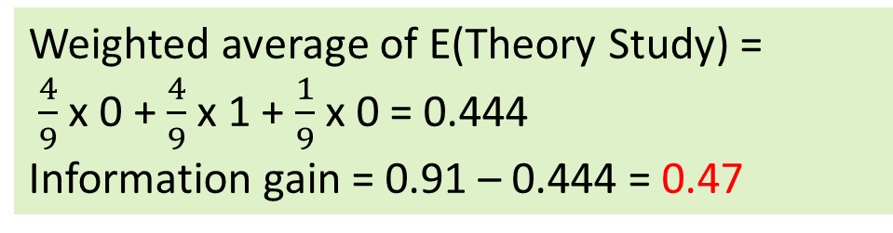

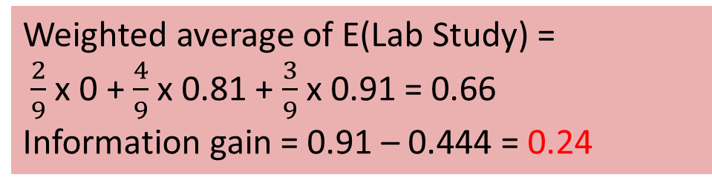
Solution
Theory Study | Lab Study | Pass Exam
High | High | Yes
High | Medium | Yes
High | Medium | Yes
High | Low | Yes
Medium | High | Yes
Medium | Medium | No
Medium | Medium | Yes
Medium | Low | No
Low | Low | No
Overall entropy = $\frac{6}{9}$ log₂ $\frac{6}{9}$ + $\frac{3}{9}$ log₂ $\frac{3}{9}$ = 0.91
Splitting on Theory study
E(High) = $\frac{4}{4}$ log₂ $\frac{4}{4}$ + $\frac{0}{4}$ log₂ $\frac{0}{4}$ = 0
E(Medium) = $\frac{2}{4}$ log₂ $\frac{2}{4}$ + $\frac{2}{4}$ log₂ $\frac{2}{4}$ = 1
E(Low) = $\frac{0}{1}$ log₂ $\frac{0}{1}$ + $\frac{1}{1}$ log₂ $\frac{1}{1}$ = 0
Splitting on Lab study
E(High) = $\frac{2}{2}$ log₂ $\frac{2}{2}$ + $\frac{0}{0}$ log₂ $\frac{0}{0}$ = 0
E(Medium) = $\frac{3}{4}$ log₂ $\frac{3}{4}$ + $\frac{1}{4}$ log₂ $\frac{1}{4}$ = 0.81
E(Low) = $\frac{1}{3}$ log₂ $\frac{1}{3}$ + $\frac{2}{3}$ log₂ $\frac{2}{3}$ = 0.91
Weighted average of E(Theory Study) =
$\frac{4}{9}$ x 0 + $\frac{4}{9}$ x 1 + $\frac{1}{9}$ x 0 = 0.444
Information gain = 0.91 – 0.444 = 0.47
Weighted average of E(Lab Study) =
$\frac{2}{9}$ x 0 + $\frac{4}{9}$ x 0.81 + $\frac{3}{9}$ x 0.91 = 0.66
Information gain = 0.91 – 0.444 = 0.24

Slide 11
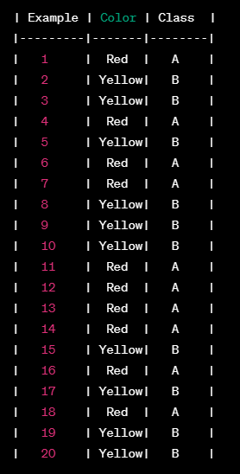
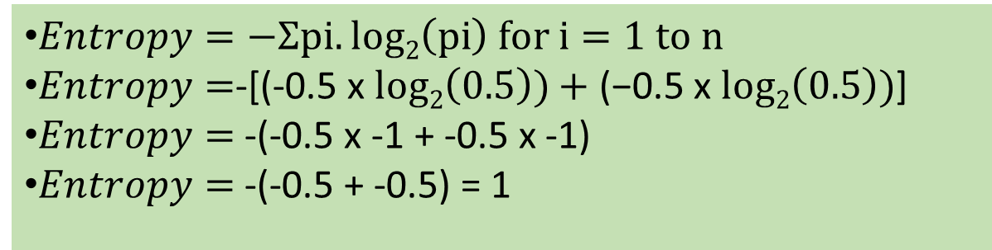
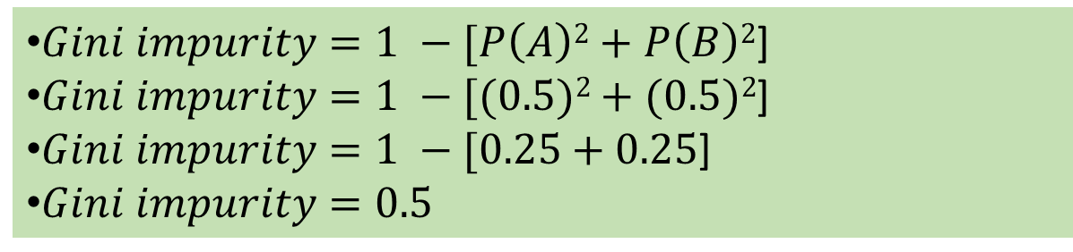
Gini Index/Coefficient/Impurity
P(A) = 10/20 = 0.5
P(B) = 10/20 = 0.5
Gini impurity Alternative to entropy (Lower the better, 0 is the best)
Example: Predict fruit: A or B
$Entropy=−Ʃpi.log2\left(pi\right) for i=1 to n$
$Entropy=$-[(-0.5 x $log2\left(0.5\right))+\text{(−0.5 }\text{x} log2\left(0.5\right))$]
$Entropy=$ -(-0.5 x -1 + -0.5 x -1)
$Entropy=$ -(-0.5 + -0.5) = 1
$Gini impurity=1 −[P\left(A\right)2+P\left(B\right)2$]
$Gini impurity=1 −[(0.5)2+(0.5)2$]
$Gini impurity=1 −[0.25+0.25$]
$Gini impurity=0.5$

Slide 12
When We Have More Classes
Consider we have three classes with probabilities of 0.4, 0.4, and 0.2 respectively
Gini impurity = 1 - (p1^2 + p2^2 + p3^2)
Gini impurity = 1 - (0.4^2 + 0.4^2 + 0.2^2)
Gini impurity = 1 - (0.16 + 0.16 + 0.04)
Gini impurity = 1 - 0.36
Gini impurity = 0.64
Conclusion: More classes, higher Gini impurity

Slide 13
Linear Programming Problem (LPP)

Slide 14
What is Linear Programming Problem (LPP)?
Linear Programming Problem (LPP): Mathematical method to find the best possible outcome (e.g. maximize profit/minimize loss) in a situation where we have limited resources
Key concepts: Objective function and Constraints
Objective function: Our goal, e.g. Maximize: Profit = 5x + 3y, where x and y are quantities that we can control
Constraints: Limitations, e.g. limited raw material, time, money, e.g. x + y <= 100

Slide 15
LPP Example
Problem
We run a factory making chairs (Rs 300 profit per chair sold) and tables (Rs 1,000 profit per table sold)
We 400 units of wood: One chair needs 5 units, one table needs 10 units
We have 300 hours of worker time: One chair takes 2 hours, one table needs 6 hours
How many tables and chairs should we make to maximize profit?
Steps
Objective function: Maximize 300x + 1000y (profit)
Constraints
5x + 10y <= 400
2x + 6y <= 300
x, y >= 0 (Non-negative quantities)
LPP_chairs_tables.py

Slide 16
Car Example
A car manufacturer manufactures two cars A and B
There are one robot, two engineers, and one detailer at work
The detailer is going on a short holiday, so he only has 21 working days available
The two cars need the following resource times
Robot time: Car A – 3 days; Car B – 4 days
Engineer time: Car A – 5 days; Car B – 6 days
Detailer time: Car A – 1.5 days; Car B – 3 days
Car A provides €30,000 profit, whilst Car B offers €45,000 profit
Optimize the car production
LPP-car.py
Decision variables
x = Number of A cars to be produced
y = Number of B cars to be produced
Objective function
Maximize Z = 30000x + 45000y
Constraints
Robot time (R): 3x + 4y <= R
Engineer time (E): 5x + 6y <= 2E
Detailer time (T): 1.5x + 3y <= 21
Non-negativity: x >= 0, y >=0
Problem
Find Maximum Z

Slide 17
Summary
Objective function
Maximise Profit = 30,000 x A + 45,000 x B
Constraints
A≥0
B≥0
3A+4B≤30
5A+6B≤60 ... Note that we have 2 engineers, so this is not 30; but it is 60
1.5A+3B≤21

